Slide 1



Shanxi Huasheng Fruits & Vegetables
Drinking Co., Ltd.
Pepperdine Univ. M.S. Organizational Development
Sue Gonzalez, Louise Keefe, Ana Villarreal, Carol Watson, Elaine Zitner

Slide 2


Agenda
What we heard from you & why we asked
Questions we intend to answer
Leadership competencies models
Measuring leaders – performance management
Advanced management processes
Generational differences
Open dialogue

Slide 3
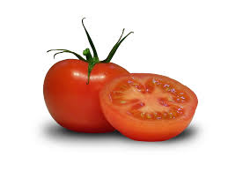
Introducing the Star Model:
Framework for Organizational Assessment & Design
Strategy
战略
Structure
组织 结构
Management Processes
过程
Rewards
奖赏
People
人才
CULTURE
文化
Adapted from J. Galbraith, Star Model
Notes:
Say:
Eaton’s OD community partnered with Jay Galbraith and the University of Southern California’s Center for Effective Organizations to adapt their Star Model. This model is the most widely used and recognized, tested over decades of use in hundreds of large and small organizations. All OD leaders and many of the senior HR leaders in Eaton have experience in design, and have now been trained in the use of this model and supporting process so they can support your efforts.
As you can see, the model incorporates the key elements of an organization’s design in order to help you consider what is most important and better anticipate/eliminate the characteristics and disruption of ineffective organizational changes.
Transition:
Let’s see an example of how this model works in practice

Slide 4
Why These Elements Are Important
Strategy
战略
Structure
组织 结构
Process
过程
Rewards
奖赏
People
人才
If strategy is missing, unclear, or not agreed upon
If the structure isn’t aligned to the strategy
If the development of coordinating mechanisms is left to chance
If the metrics and rewards don’t support the goals
If people aren’t enabled and empowered
CONFUSION
混乱
FRICTION
不和
GRIDLOCK
停顿
INTERNAL
COMPETITION
内部竞争
LOW
PERFORMANCE
低效益
No common direction; people pulling in different directions
No criteria for decision making
Inability to mobilize resources
Ineffective execution; lost opportunity for competitive advantage
Lack of collaboration across boundaries
Long decision and innovation cycle times
Difficult to share information and leverage best practices
Wrong results; diffused energy
Low standards
Frustration and turnover
Effort without results
Low employee satisfaction
Designing Dynamic Organizations,
Galbraith & Kates, 2002
Notes:
Note: the bottom half of the slide showing ineffective characteristics are displayed immediately.
Do:
Highlight any ineffective characteristics on the slide the teams identified in their exercise – link to boxes on bottom of this slide
Point out any they missed (explain these are often common characteristics experienced in organizations with ineffective restructures)
Explain the underlying problem for each characteristic (click to reveal)
Ex: confusion can often occur because the strategy is unclear (click to reveal strategy)
Transition:
As you’ve seen, organizational design is much more than designing a structure. Five key aspects of the organization need to be assessed and designed to ensure alignment, which helps people work together to achieve the overall strategy and work at highest levels of performance.
Next, I’ll show you a working definition of “organizational assessment and design”

Slide 5
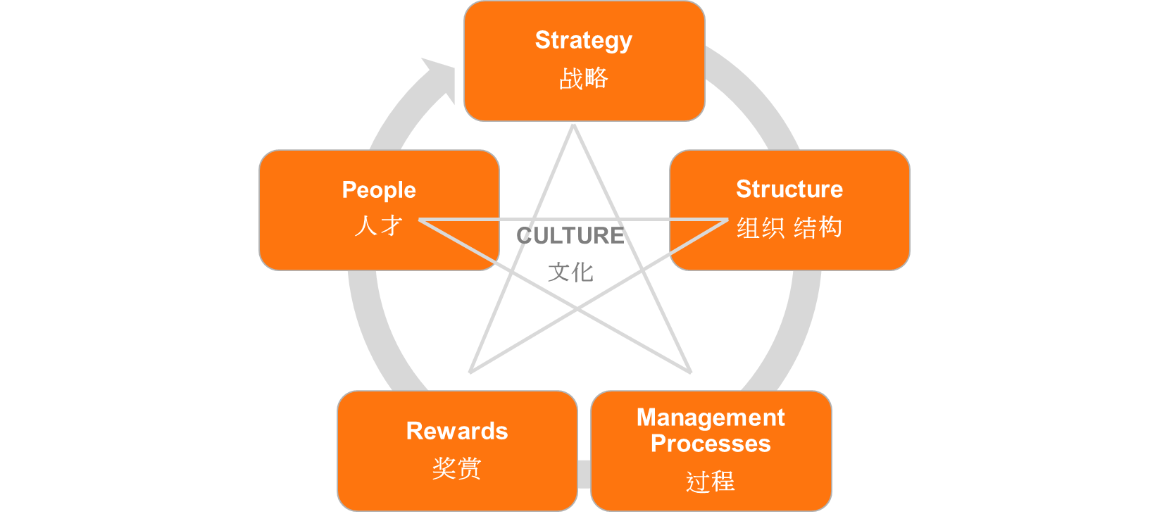

What We Heard…
Strategy:
Mission: To make farmer’s life better, improve society and enjoy new products
Goals: To be the most outstanding enterprise in China by 2015; Improve Quality and Quantity
Values: Quality, Teamwork, Just Do It, Creativity, Social Responsibility
Culture:
Civic Spirit
Military
School
Family
Structure:
Department / Regional Structure
Collaborative communication and decision making across work groups
People
Leadership skills
Training and skills per job role
Management Processes:
Weekly Meetings, Monthly Newsletter
Performance measurements and evaluations
Formal business processes (ISO certified)
Plan -> Do -> Check -> Act
Rewards:
Progressive career paths
Fair compensation
Learning & Development

Slide 6
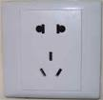
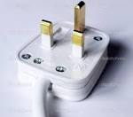

Slide 7
Questions You Asked Us
How to inspire and motivate our staff and enhance loyalty within the corporate culture
How do US companies manage agriculture export and agricultural products
Introduce advanced principles management
Middle level – how to improve skills
How American organizations measure and manage performance of staff, how does senior management measure performance of it’s employees
What does a good leader look like in the United States
How does the US address motivational differences between generations
How to make work more efficient and effective
How to increase performance and revenue

Slide 8
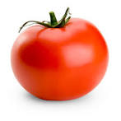
Which Leader is Better?
Leader A
Leader B
战略眼光 - Strategy
决策质量- Decision making
管理与衡量工作 – Management and evaluation of work
培养下属和其他人员 – Employee Training
正直可靠 – Reliable and trustworthy
商业头脑 – Business skills
追求卓越成效 – Visionary
应对不明朗局面 – Problem solving
激励他人 – Motivate others
善于社交 – Communication skills

Slide 9
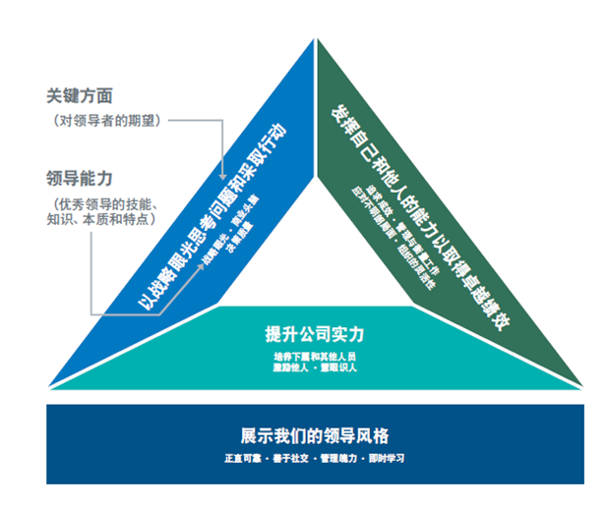
Leadership Model

Slide 10
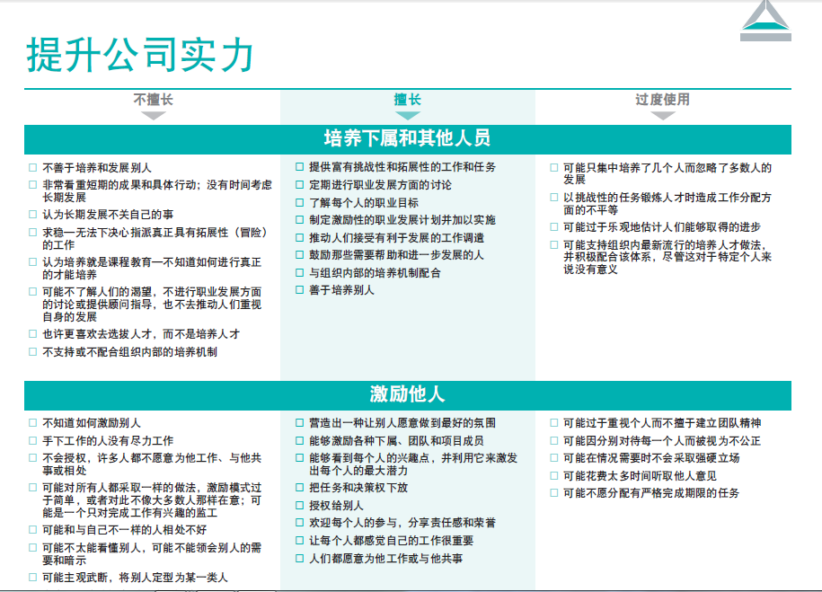
Building Organizational Capability

Slide 11
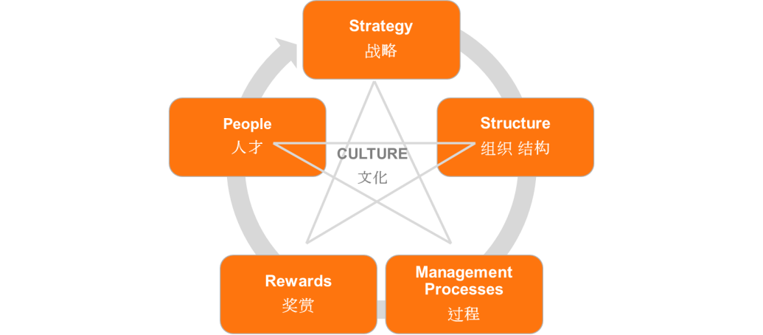
Performance Management Process
Desired
Leadership
Abilities
Ongoing Feedback
Strategy
Culture
Measure
Goals & Competencies
Evaluate &
Provide Feedback
Defined
Goals

Slide 12

怎样评估绩效？
作为绩效管理流程的内容之一，绩效评估每年举行，根据目标、能力和职业发展计划衡量个人绩效。
  绩效评估的依据是取得了什么成就以及用什么方式取得成就。
  如果员工取得的业绩很好，但在道德、领导力或技能方面却有欠缺，则该员工不符合绩效预期。

Slide 13
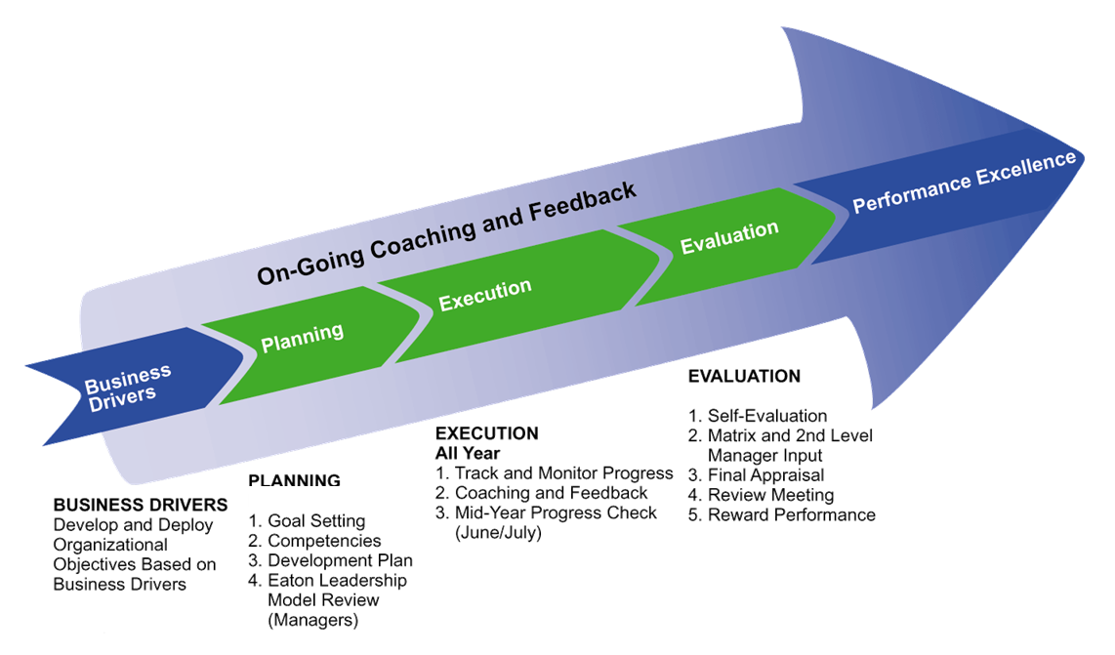
Performance Management

Slide 14
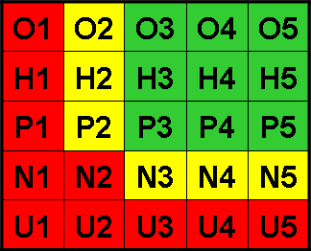
绩效评级代码
双维度评级体现伊顿对“取得了什么成就”和“用什么方式取得成就”的重视。
成就（目标）/
“取得什么成就”
  Outstanding（杰出）
  Highly Effective（高效）
  Performing（达标）
  Needs Improvement（需要改善）
  Unsatisfactory（不满意）
行为（能力）/
“用什么方式取得”
    5（高）
    4
    3
    2
    1 （低）
评级时应每栏选择一项

Slide 15
评级标准——成就
O | Outstanding（杰出）出色地完成工作职责。 与目标相比，取得卓越的成就和业绩。 为他人树立典范。
H | Highly Effective（高效）高效地履行工作职责。 考虑到目标的难度、资源可用性以及全年的变化，取得的成就很出色。
P | Performing（达标） 正常履行工作职责，并能想办法提高自己的业绩标准（持续改善）。考虑到目标的难度、资源可用性以及全年的变化，与目标相比，取得的成就完全令人满意。
N | Needs Improvement（需要改善）在履行日常工作职责和/或提高业绩和成就方面需要改善。 或许能够听取意见，但需要提高主动性并寻找持续改善的方法。 加强指导、反馈和/或改善计划或许有利于实现改善。
U | Unsatisfactory（不满意）： 在履行工作职责和/或取得业绩方面存在严重差距。 需要立即进行持续改善。

Slide 16
评级尺度——行为
1
2
3
4
5
I I I I I
未展示自己的能力，或者可能观察到不良行为。
行为妨碍其综合成绩/绩效，是该员工的弱点。
了解伊顿的高预期目标，始终展示其熟练的工作技能/工作成效。 积极发展提高自己业绩所需要的工作技能和行为。
被视为典范；展示自己精通相关技能、能力和知识；被视为/应当被视为其他人效仿和学习的标准。 通常能为他人树立典范。

Slide 17
Performance Management in Your Organization

Slide 18
Advanced Management Practices

Slide 19
Advanced Management Processes
Appreciative Inquiry
Neuroscience
Emotional Intelligence
Change Management

Slide 20
Generational Differences

Slide 21
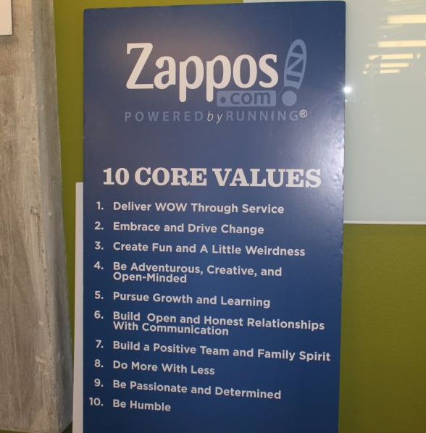
Generational Differences
How American Companies are Adapting
Zappos
Cross – job training
Formal mentoring
Community involvement
Project assignments
Engage in decision making

Slide 22

Generational Differences
Millennials (approximately 1982 – 2003 age range)
What Makes them Different from Older Generations
Love to engage with others, very participatory
Communicates primarily thru technology
Frequent feedback
Meaningful work/easily bored
Entrepreneurial
Work with smart, creative people
Multitasking
Work to live
Civic duty/environment

Slide 23
Open Dialogue

Slide 24
Additional References

Slide 25

How to Write an Effective Goal
S.M.A.R.T goals include all of the following necessary elements:
  S = Specific
  M = Measurable
  A = Attainable
  R = Realistic
  T = Time-based

Slide 26




怎样制订有效的目标？
S.M.A.R.T目标包括下列所有必要的要素：
  S = Specific（明确）
  M = Measurable（可衡量）
  A = Attainable（可达成）
  R = Realistic（切合实际）
  T = Time-based（有时效）

Slide 27
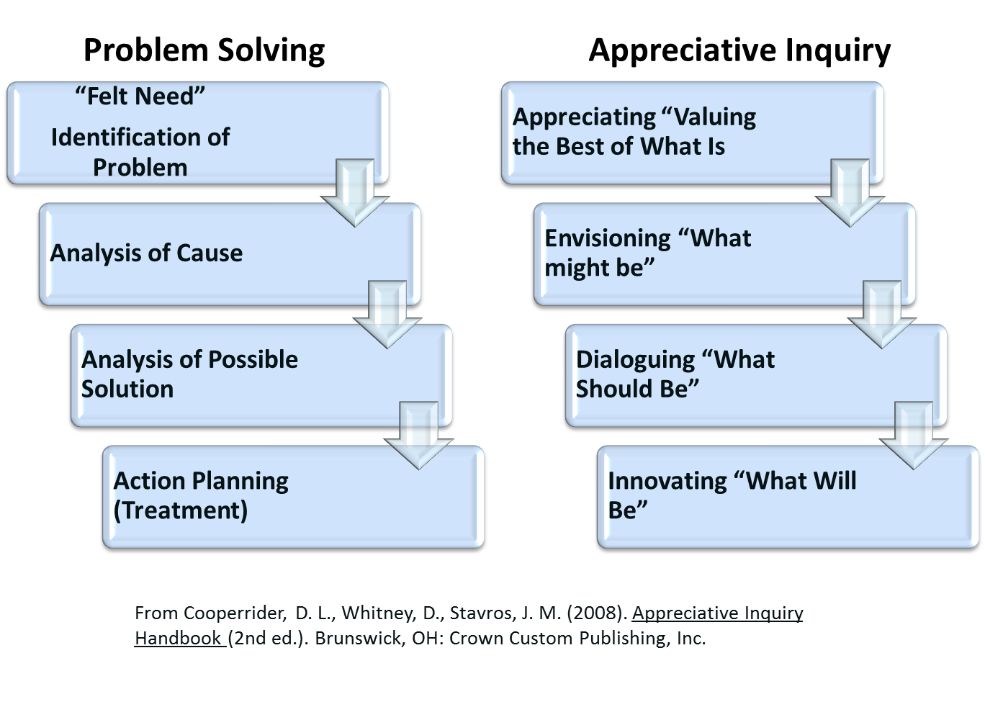
Traditional Problem Solving Vs Appreciative Inquiry

Slide 28
Change Management
Awareness of the need to change
Desire to support and participate in the change
Reinforcement to sustain the change
Knowledge about how to change
Ability to implement the change
A
The nature of the change.
Why is the change happening?
What is the risk of not changing?
D
Personal motivation to support the change.
Organizational drivers to support the change.
K
Understanding how to change.
The details of what to do.
A
Demonstrated ability to implement the change.
R
  Recognition, rewards, incentives, realized benefits.
Copyright 2014 Prosci. All writes reserved

Slide 29
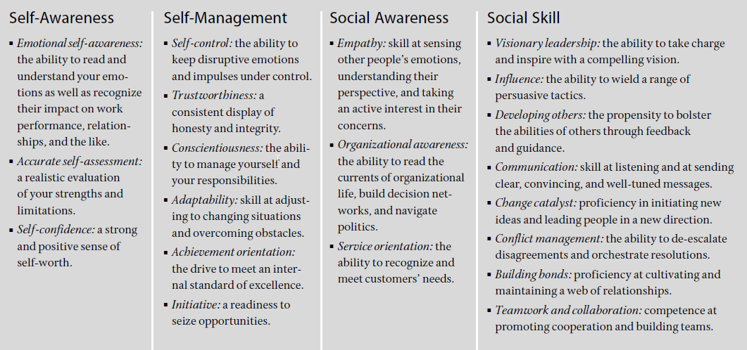
Emotional Intelligence
Daniel Goleman

