Slide 1



Recommendations from Pepperdine MSOD Student
June 27, 2013 (original presentation)
Notes:
Clasquin has a 140+ year history air, maritime and specialty logistics and transport for the pharmaceutical and luxury product industries. With 47 offices in 5 countries, Calsquin is well-positioned to take the next step in their global expansion.
M. Jerome Baudry serves Clasquin as global VP of Sales. He contracted with Pepperdine University Students to receive consulting regarding implementing his international sales strategy in a sustainable manner.

Slide 2
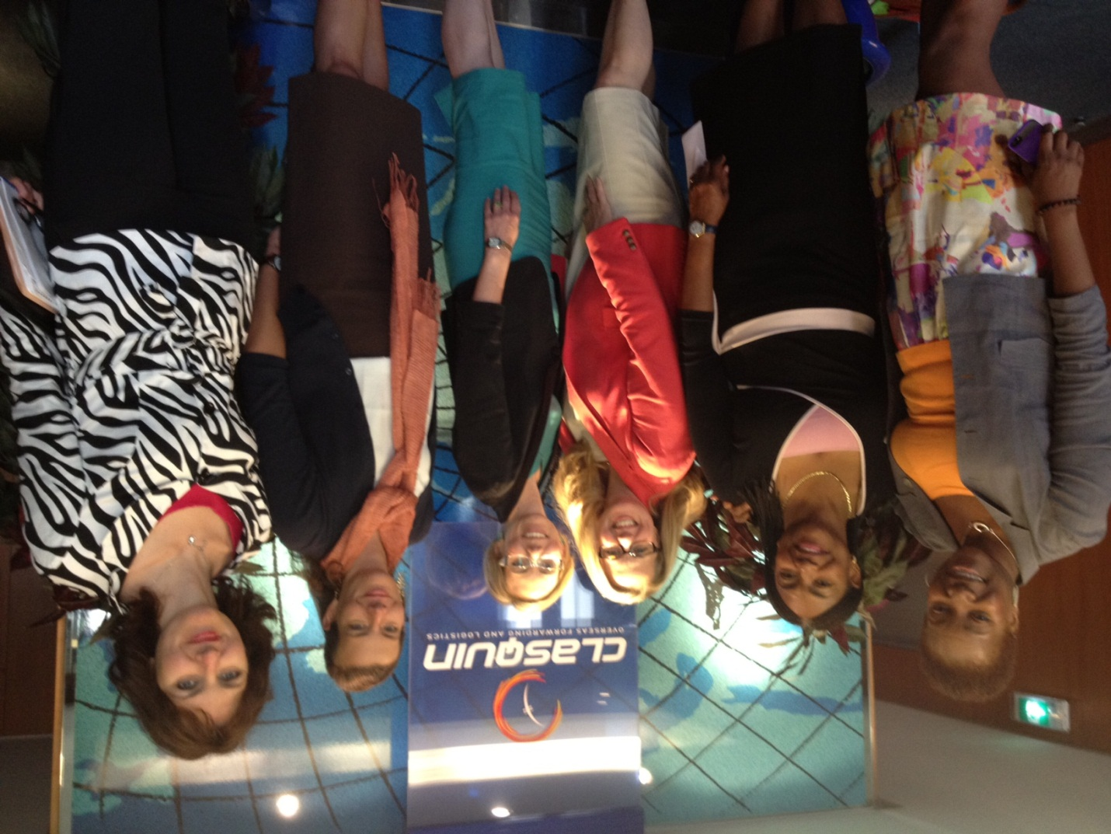


Presented by:
Pepperdine MSOD Team
Carol Watson, Dawnet Beverley, Louise Keefe, Antonia Nicols & Lacey Croco

Slide 3
What we heard…
Global sales strategy
Sales Target 2015
TEAM/CONSIGNEE SELLING (CRM, Leads,…)
GP in €uros
LARGE CLIENTS ACQUISITION (KA list, Pipeline
SME / VERTICAL MARKETS (W&S, F&T, …)
PEOPLE EMPOWEREMENT (Training, MBO’s, …)
2012
2013
2014
2015
Notes:
Overarching sales strategy

Slide 4
What We Heard
Sales
Strategy
Sales Force Development
Team Engagement
Notes:
Sales strategy is developed and approved by executive team
Desire to develop a world-class sales force
Buy-in and engagement across the global sales force is the desired outcome

Slide 5
The question that we addressed…
How can Clasquin implement a sustainable global sales strategy?

Slide 6
Clasquin's Successes
A winning culture
Year over year over year growth
Tools are in place to increase the cohesiveness of teams
Well positioned for global expansion
Notes:
Wining culture –
Jerome’s new hire, expansion of China, leadership
year over year performance, business growth and company achievement
Doubled company size in five years
Branch team compensation plan
Role out of CRM

Slide 7
Possible Barriers
Communication process and methods are lacking
Current organizational structure is confusing
Process for understanding current sales force state is needed
Notes:
The organization of the direct report structure of the Sales Force
Lack of communication and understanding of the Vice President of Sales role –Power/authority balance - Limited structure to create business buy-in
Inconsistent training across the sales force
Client information flow – largest clients, information and relationship with the complete sales team
Assessing progress
CHECK IN with Ann-Cecil

Slide 8
Sales
Transformation
Organization
Transformation
Sales
Strategy
Sales Force Development
Team Engagement
CHANGE MANAGEMENT
LEADERSHIP/SPONSORSHIP
EMPLOYEE INVOLVEMENT
Notes:
Stop for feedback/space for comments from client
To get to Jerome’s 2015 (3 year) goals we would like to provide a framework to achieve those goals focused on his 4 pillars
We are recommending a process of change management. The foundation of team engagement leading up to the development of a professional sales team in alignment with the sales strategy that is co-created with the sales force to ensure sustainability and full engagement.
This transformation is anchored change management principles focus/process and a focus
Leadership competencies specifically necessary for effective change management include:– communication, inspire, compassionate, nurturing, persistent, emotional intelligence

Slide 9
What could it look like?
Team Engagement
Sales Force Development
Sales Strategy
Sales force embraces the strategy and vision
Sales force is passionate about becoming a world class organization
Employees are empowered and engaged
Current and new employees are trained and understand the expectations for a professional workforce
Regular coaching and feedback are provided to increase competency
Sales managers understand their responsibility in supporting the developmental goals
Sales strategy is clearly communicated, individuals understand how their role aligns and supports the strategy
Individuals co-create strategy deployment with management

Slide 10
Recommendations
Change Management
Employee Involvement
Leadership/ Sponsorship

Slide 11

ADKAR Model
Change Management
Awareness of the need for change
The nature of the change
Why is the change happening?
What is the risk of not changing?
Desire to support and participate in the change
Personal motivation to support the change.
Organizational drivers to support the change.
Knowledge about how to change
Understanding how to change.
The details of what to do.
Ability to implement the change
Demonstrated ability to implement the change.
Reinforcement to sustain the change
  Recognition, rewards, incentives, realized benefits.
Copyright Prosci 2012. All rights reserved.

Slide 12
Change Channels
Change Management
Change Management
Tools
ADKAR
phases of change
Communications Plan
Awareness
Sponsor Roadmap
Desire
Training Plan
Knowledge
Resistance Management
Plan
Ability
Coaching Plan
Reinforcement
Copyright Prosci 2012. All rights reserved.

Slide 13
Key Recommendations
Change Management
Employee Involvement
Leadership/ Sponsorship

Slide 14
Leadership / Sponsorship
Leadership/ Sponsorship
Necessary competencies to drive change:
  Influencing skill, advocacy, ability to coach others, inspirational, compassion, nurturing, persistence, emotional intelligence
Executive coaching for top leaders
Leveraging executive team to sponsor change

Slide 15
Recommendations
Change Management
Employee Involvement
Leadership/ Sponsorship

Slide 16
Employee Engagement
Employee Involvement
Establish baseline and track
Create feedback system that allows for employee input
Create cross-organization teams for training and engagement
Continue to build direct links between sales management & VP of Sales

Slide 17
Recommended Next Steps

Slide 18
Questions About Our Recommendations
Change Management
Employee Involvement
Leadership/ Sponsorship

Slide 19
Appendix

Slide 20
Survey Situational Usage
Surveys are ideal for:
Interviews are ideal for:
Gathering quantitative data
Uniform data collection across a large population (i.e. entire sales force, country region, etc.)
Assessing trends
Annual employee engagement
Specific needs assessment
Gauge people’s interest in specific topics
When a topic or initiative needs to be rated
Uncovering hidden needs
Probing deeply into one topic
Creating relatedness
Gain individual perspective
Understanding a greater context
Gain greater clarity around data points
Capture important nuances within the organization
Often inspires personal buy-in of the interviewee regarding interview topic

Slide 21
Using Appreciative Inquiry (AI) in interviews
Appreciative inquiry is an approach that is used to:
Cultivate hope
Build capacity
Unleash collective appreciation and imagination
Encourage enrollment and alignment
Bring about positive change

Slide 22
The AI 4-D Model of Positive Change
Discovery
“What gives life?”
The best of what is.
Appreciating
Destiny
“How to empower,
learn, and improvise?”
Sustaining
Dream
“What might be?”
Envisioning
Results/Impact
Affirmative
Topic
Design
“What should be –
the ideal?”
Constructing the
future
From Cooperrider, D. L., Whitney, D., Stavros, J. M. (2008). Appreciative Inquiry Handbook (2nd ed.). Brunswick, OH: Crown Custom Publishing, Inc.
Notes:
AI focuses in on the exceptional best of “what is” DISCOVERY to help spark the imagination of “what might be” DREAM. The purpose is to create new knowledge of a desired future state.
DISCOVERY – Individuals engage in dialogue & meaning making – possibilities, the best
DREAM – envisioning what could be, creating a positive image of the future, expand people’s sense of what is possible`
DESIGN – combination of what has worked in the past combined with new ideas, grounded in reality, to create the future
DESTINY - _______________________--

Slide 23
Sample AI Questions
Issue to be uncovered:
Developing Sales Training Programs: Professional and Solution Selling
Desired outcome: To identify the skills and techniques to make your team more effective:
Describe the most effective sales meeting you have ever had:
  What made it unique?
  What did you say?
  What was the impact?
Desired outcome: To create an effective training program:
Describe your favorite teacher at school:
  Why were they your favorite?
  How did they convey the information to you?
  Why do you think you retained the information they taught you?

